Slide 1
山西省公正转型的挑战和行动
The Challenges and Actions of Just Transition in Shanxi Province

Slide 2
关于科城研究院
About Coshare Environment
科城研究院于2017年1月成立，是一家以推动区域可持续发展为目标的独立非营利研究机构和协同创新平台，联合国气候变化框架公约观察员机构。致力于为政府、企业和公众提供绿色低碳转型解决方案。
Established in 2017, Coshare Environment, is an independent non-profit research organization with the aim of promoting regional sustainable development. Coshare has committed to providing government, industries and the public with innovative solutions to efficiently shift to a greener, low carbon future.

Slide 3
山西煤炭行业发展现状
Coal Industry in Shanxi Province
公正转型行动
Actions on Just Transition
公正转型挑战
Challenges of Just Transition

Slide 4
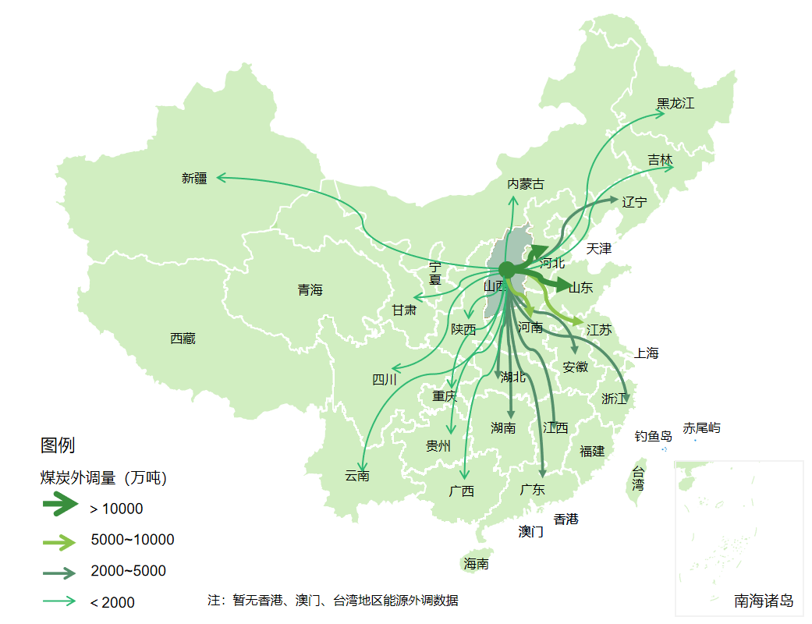
山西煤炭行业发展现状
Coal Industry in Shanxi Province
图 煤炭外调量（万吨）
Fig. Coal Transfered to Other Provinces (ten thousand tons)
山西煤炭供应全国28个地区，并出口到全球23个国家和地区。
Coal produced in Shanxi Province has been supplied to 28 regions across China, and exported to 23 countries and regions around the world.
2021年，外调煤炭7.60亿吨，外调量占产量比重达到63.14%。
In 2021, the amount of coal transfered to other provinces was 760 million tons, and the proportion of it to production reached 63.14%.

Slide 5
山西煤炭行业发展现状
Coal Industry in Shanxi Province
山西省是世界五大煤炭主产地之一，中国重要的煤炭基地。2022年，山西煤炭产量达到13.07亿吨，占全国产量的29.04%，居全国第一。
Shanxi Province is one of the world's five largest coal production areas and an important coal base in China. In 2022, Shanxi coal production reached 1.307 billion tons, accounting for 29.04% of the national output, ranking first in the country.
山西省原煤产量（2015-2022）
Coal Production of Shanxi Province in 2015-2022
数据来源：山西省统计年鉴
Data Source:Shanxi Statistical Yearbook

Slide 6
山西煤炭行业发展现状
Coal Industry in Shanxi Province
2021年，煤炭开采和洗选行业占全省工业企业营收的34%，税收的66%，就业的44%，资产的52%。
In 2021, the coal mining and dressing industry accounted for 34% of the total revenue of industrial enterprises in the province, 66% of tax revenue, 44% of employment, and 52% of assets.
山西省部分产煤大县，煤炭相关产业占全县经济总量的近80%；
In some major coal-producing counties in Shanxi Province, the coal-related industries account for nearly 80% of the county's total economic output.
数据来源：山西省统计年鉴
Data Source:Shanxi Statistical Yearbook

Slide 7
山西煤炭行业发展现状
Coal Industry in Shanxi Province
山西省煤炭行业就业人数全国第一，2022年占全国同行业比重的33%，较2017年增加7.05个百分点。
The number of employees in the coal industry in Shanxi Province ranked the first in the country, accounting for 33.29% of the national share of the same industry in 2022, an increase of 7.05% over 2017.
2017-2021年山西煤炭行业用工人数及全国占比
Number of employees of coal industry in Shanxi and the national share in 2015-2022
数据来源：中国、山西省统计年鉴
Data Source:China and Shanxi Statistical Yearbook

Slide 8
山西煤炭行业发展现状
Coal Industry in Shanxi Province
表 山西省2023-2020年采矿业人员工资
Table. Shanxi Ming Industry Personnel Wages in 2103-2020
山西省采矿业人员平均工资长期高于山西省平均工资水平，但差距在逐步缩小。
The average salary of personnel in the coal mining and dressing industry in Shanxi Province has long remained higher than the average salary level in Shanxi Province, but the gap is gradually narrowing.
年份 Year | 城镇非私营单位采矿业人员工资 Wage of Minging Employees in Urban Non-private Units | 城镇私营单位采矿业人员工资 Wage of Minging Employees in Urban Private Units
 | 平均工资（元） | 平均工资（元）
2013 | 69039 | 37694
2014 | 66516 | 34356
2015 | 58815 | 38997
2016 | 56413 | 38096
2017 | 65670 | 41366
2018 | 73380 | 45346
2019 | 81324 | 50226
2020 | 86091 | 52611
数据来源：山西省统计年鉴
Data Source:China and Shanxi Statistical Yearbook

Slide 9
公正转型行动
Actions on Just Transition
能源转型
Energy Transition
就业安置
Job Placement
Regulations on the Protection of the Fenhe River in Shanxi Province
生态环境修复
Ecosystem Restoration
经济多元化
Economic Diversification
Regulations of Jincheng on Wetland Park Protection(Draft)

Slide 10
公正转型行动-就业安置
Actions on Just Transition：Employment Placement
山西相继出台《关于全力做好职工就业安置的实施细则》《关于做好化解煤炭钢铁行业过剩产能职工安置工作的实施意见》等政策，通过内部安置、外部分流、转移就业、创新创业、自主择业、培训转岗、内部退养、公益性岗位托底安置等多种方式妥善推进职工安置。2016年和2017年去产能职工安置率分别为99.6%和88.6%。
Shanxi has issued "the Implementation of the Rules of Employment and Resettlement of Workers" “Implementation Opinions on Effectively Resolving the Placement of Surplus Employees in the Coal, Steel and Iron Industries”and other policies. By various measuares such as internal job placement, external job transfer, job retraining, innovation and entrepreneurship, self-employment, vocational training for job transition, internal retirement,and public welfare job placement, the job placement of employees was properly carried out. The placement rates for laid-off workers due to overcapacity were 99.6% and 88.6% in 2016 and 2017.
出台职工安置政策
Introduce policies for employee placement
明确各类资金的具体来源
Specify the sources of funds
图 2016年山西省煤炭行业去产能职工分流安置渠道
Fig. Replacement Channels for Cutting Overcapacity Employees of Coal Industry Shanxi Province in 2016
数据来源（DataSource）
提供财政资金支持
Provide financial funding support
加强交流对话
Strengthen dialogue among stakeholders

Slide 11
公正转型挑战
Challenges on Just Transition
挑战一 Challenge One
山西省煤炭行业就业人数全国第一，地方安置压力大
Shanxi province has the largest number of employees in the coal industry in China, which creates a great pressure for local job placement。
山西省煤炭行业就业人数是内蒙古和陕西地区煤炭行业就业人数之和的2.56倍，煤炭行业全员功效低。伴随着智能化和“双碳”政策的推进，劳动生产率提升和煤炭减量将带来大量煤炭行业减员。
The employmees in Shanxi's coal industry is 2.56 times that of the total in Inner Mongolia and Shaanxi, leading to a lower larbor productivity. Along with the promotion of intelligence and " Double Carbon" policy, labor productivity improvement and coal reduction will bring a large number of coal industry staff reduction.
图 晋陕蒙年煤炭行业劳动生产率
Fig Labor productivity in the coal industry of Shanxi, Shaanxi, and Inner Mongolia
数据来源：山西、内蒙古、陕西统计年鉴
Data Source: Shanxi, Shaanxi, Inner Mongolia Statistical Yearbook

Slide 12
公正转型挑战
Challenges on Just Transition
挑战二 Challenge Two
煤炭行业就业人员转型能力有待提高
Coal industry employees face inadequate ability for transitioning to new employment opportunities.
40周岁以上占58%
58% over 40 years old
山西省煤炭行业就业人员结构呈现年龄大，男性多，学历低的特点，技能相对单一，择业创业积极性不高，就业安置挑战大。女性岗位替代性强，失业风险高。
Coal industry employmees of Shanxi Province show the characteristics of older, men dominant, low education, relatively single skills, low motivation to transition, leading to big challenges in job placement for future. Female jobs are highly substitutable, with a higher risk of unemployment in the future.
男性占比80%以上
80% of the total are male
专科及以下学历程度占88.7%
88.7% of the total with vocational school education or below
数据来源：山西科城能源环境创新研究院企业调研数据
Data Source: Survey data from Coshare Environment.

Slide 13
公正转型挑战
Challenges on Just Transition
挑战三 Challenge Three
战略性新型产业仍处于培育阶段，支撑能力有限
Strategic new industries are still in the cultivation stage, with limited support capacity.
山西省产业结构、能源结构的高碳特征仍然比较明显。战略性新型产业规模小，对经济和就业的贡献有限。
Shanxi Province is still dominated by high carbon industries and energy structure. Strategic new industries are small in scale, with limited contribution to the local economy and employment absorption.
图 2021年山西省重点行业就业和营业收入占比
Fig.Share of Employment and Revenue in Key Industries of Shanxi Province in 2021
数据来源：山西统计年鉴
Data Source: Shanxi Statistical Yearbook

Slide 14
公正转型挑战
Challenges on Just Transition
挑战四 Challenge Four
图 中部六省份旅游收入
Table. Tourism Income in Six Central Provinces
煤炭产业与旅游服务业发展存在冲突
The conflict between coal industry and tourism service industry development
单位：亿元（100 million yuan）
年份 Year | 山西省 Shanxi | 安徽省 Anhui | 河南省 Henan | 江西省 Jiangxi | 湖北省 Hubei | 湖南省 Hunan
2005 | 291.99 | 289.00 | 800.20 | 320.02 | 473.15 | 453.62
2010 | 1083.46 | 1094.80 | 2294.80 | 818.32 | 1460.53 | 1425.80
2015 | 3447.50 | 3980.50 | 5035.29 | 3637.65 | 4308.76 | 3712.91
2019 | 8026.92 | 8291.50 | 9607.06 | 9656.38 | 6927.38 | 9762.32
旅游业和煤炭产业都是山西的优势资源产业，但在发展过程中存在诸多矛盾和冲突。
Tourism service industry is an important channel for absorbing coal employment, though it has been squeezed out by the coal industry and developed slowly.
数据来源：中部六省统计年鉴
Data Source: Statistical Yearbook of Six Central Province

Slide 15
公正转型挑战
Challenges on Just Transition
挑战五 Challenge Five
公正转型治理体系还不完善
The governance system for a just transition is not yet complete.
公正转型相关的政策体系、就业保障措施、资金来源和利益相关方合作机制仍在探索。
The policy framework, employment security measures, funding sources, and stakeholder cooperation mechanisms related to fair and just transition are still being explored.

Slide 16
网站
Website
e-coshare.com
领英
Linkedin
Coshare Environment
科城微信公众号
Coshare Environment Wechat
李莹
微博
Weibo
科城环境
联系我们
Contanct Us

